Slide 1
ONLINE MOVIE TICKET BOOKING SYSTEM
Submitted By:-
Tadme Pradip Sanjay
Madje Rohit Omprakash
Mukade Sai Fulchand
Lavate Santosh Vyankat

Slide 2
INDEX
Project Introduction
Objective
Gantt Chart
Hardware And Software Requirements
Key Features
Interfaces
Modules
Output
Future Scope
Conclution
Reference

Slide 3
PROJECT INTODUCTION
Project Title: Online Movie Ticket Booking System
Statement of Project:
This project is aimed to provide the customers facility to book tickets for cinema halls online, through which they can book tickets anytime , anywhere.
E-ticket system is basically made for providing the customer an anytime and anywhere service for booking the seat in the cinema hall and to gather information about the movies online. The user can easily be able to know about the movies released and then make the choice.
Admin can use the system to insert and delete data (e.g. film description, time table) which will update the webpage (webpage are dynamic page, changing according to the data in database). Also, admin can check the statistic information from the system.

Slide 4
OBJECTIVE OF THE PROJECT
The main purpose of our online ticket booking system is to provide another way for the customer to buy cinema ticket. It is an automatic system.
After inserting the data to database, staff need not to due with the order receive through the system. In fact, there is similar system on the internet, but there is no refund method found in the existing system.
This system is basically aimed to provide the customer the complete information of the movie, according to which the customer can book the tickets and the refund facility provides more flexibility to the system.
The goals of our system are:
1) To provide a anytime any place service for the customer
2) To minimize the number of staff at the ticket box
3) To promote the film on the internet
4) To increase the profit

Slide 5
GANTT CHART
Task | January | February | March | April | May
Requirement specification and Analysis
Design
Test Cases
Coding with unit testing
Testing
Documentation

Slide 6
HARDWARE AND SOFTWARE REQUIREMENTS
Hardware Requirements
Processor: pentium 4 or more optimum performance
Ram: Recommended 256 MB
Hard Disk: Minimum 20 GB
Software Requirements
Operating system: windows, linux, unix, mac, android
Programming Platform: PHP 5.0
Database: My SQL
Software Like: Xampp
Html5
CSS3

Slide 7
KEY FEATURES
This is the advantageous features over other existing systems.
Following are the features:
Simple and Convinient UI.
More theaters supports at discounted price.
Can watch trailers of upcoming movies.
No laggy experience.
Can book tickets at anywhere in the theater at the same time.

Slide 8
INTERFACES
User Site: At that site, user can book tickets, watch trailers, send feedback, contact with admin, check upcoming movies, can register & log in in our system.
Admin Site: At the admin site, admin can manage movies, manage users, can read user feedback, user messages/suggestions/complaints,etc.

Slide 9
MODULES
This system includes following modules:
Movies Module
Feedback Module
Contact Module
Ticket Booking Module
About Module
Login Module
Register Module, etc.

Slide 10
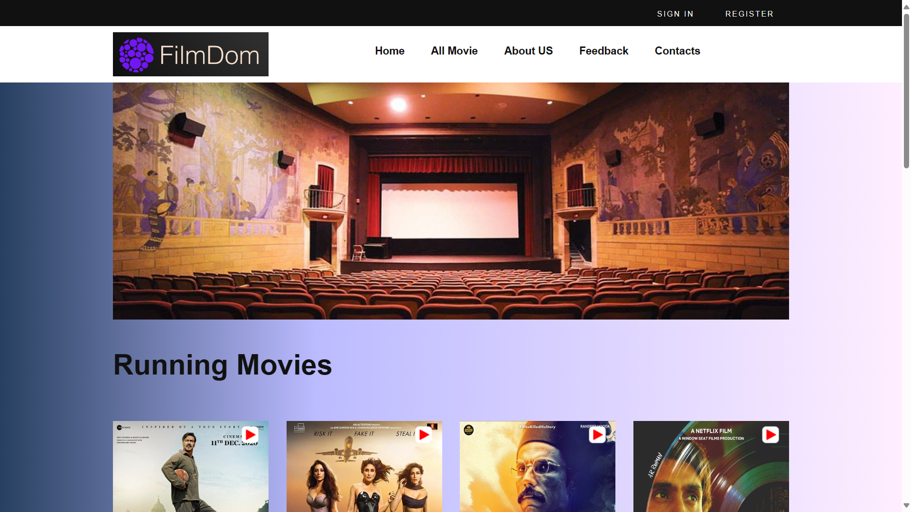
OUTPUT

Slide 11
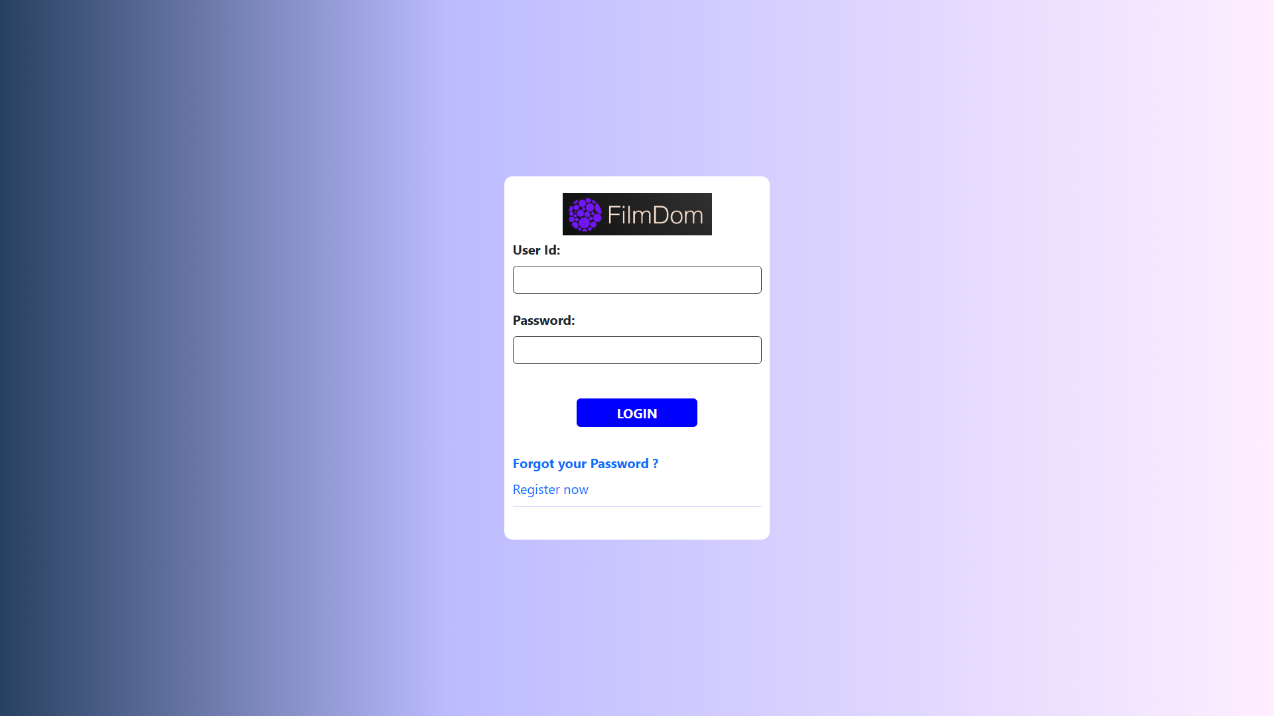
LOGIN

Slide 12
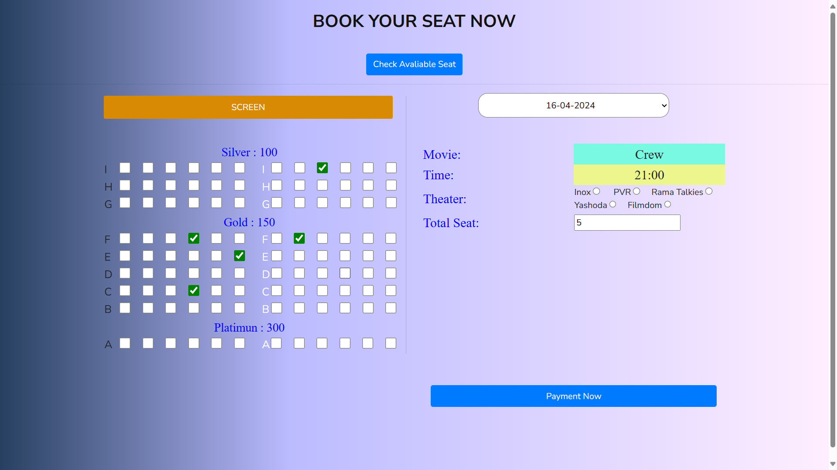
SEAT BOOKING

Slide 13
FUTURE SCOPE
In this system we will creating the streaming module, where you can watch some free movies and some paid movies which are unlocked when you buy the subscription.
Streaming movies on the same site provides better connectivity with users.

Slide 14
CONCLUTION
The entire project has been developed and deployed as per the requirements stated by the user, it is found to be bug free as per the testing standards that is implemented. Any specification- untraced errors will be concentrated in the coming versions, which are planned to be developed in near future.
The system at present does not take care of the money payment methods, as the consolidated constructs need SSL standards and are critically to be initiated in the first face; the application of the credit card transactions is applied as a developmental phase in the coming days. The system needs more elaborative technicality for its inception and evolution.
The proposed project “Online Movie Ticket Booking System” is the process whereby consumers directly buy movie tickets online from a multiplex website interactively in real-time without an intermediary service over the Internet. The Given System provides the detailed working of the Online Movie Ticket Booking Processing and what all happens whenever we or any one of us goes to book movie tickets online.

Slide 15
REFERENCES
www.w3schools.com
www.google.com
www.tutorialspoint.com
www.Phpmanual.net

